Slide 1

Real Time Chat Application
Presenter
Sukshum Gupta(2020a1r192)
Aryan sharma(2020a1r194)
DEPARTMENT OF COMPUTER SCIENCE AND ENGINEERING
MIET(Autonomous), JAMMU

Slide 2
Contents
Topics
Problem Statement
Solution
Tech Stack
Workflow
References
Future Scope
Demonstration

Slide 3



TOPICS
Java script
Python
HTML
Django

Slide 4

Role of HTML
Html stads for hypertext markup language
It is basically a standard markup language for giving a static skeleton to web application and websites
It’s a well standardized system

Slide 5

Role of Javascript
Javascript which is often known as js , is a high –level dynamic interpreted programming language
It allows client-side scripting to create completely dynamic we application and websites

Slide 6

Role of Python
The repository of this application consists of two python files, server.py and client.py. server.py is the script that runs the server, which all the clients will use to communicate to each other. And client.py will be used by the client to connect to server and send messages to other clients

Slide 7

Role of Django
Django is a high-level Python web framework that enables rapid development of secure and maintainable websites. Built by experienced developers, Django takes care of much of the hassle of web development, so you can focus on writing your app without needing to reinvent the wheel

Slide 8
Training Topics
Introduction
History
Features
Setting up path
Working with Python
Basic Syntax
Variable and Data Types
Operator
Function
Defining a function
Calling a function
Types of functions
Function Arguments
Anonymous functions
Global and local variables
String Manipulation
Accessing Strings
Basic Operations
String slices
Function and Method
Control Statements
Break
Continue
Pass
Data Structure
List
Tuple
Dictionary
Conditional statement
If
If- else
OOPS
Class and object
Attributes
Inheritance
Overloading
Overriding
Data Hiding
Looping
For
While

Slide 9
Training Topics(Continued)
Database
Introduction
Connections
Executing queries
Transactions
Handling error
Java script
Introduction
Java script Run time
??????
We have used topic like python , Django , HTML ,java script???? for creating our project which we will see in detail in further slides

Slide 10
Problem Statement
Before years ago, people were liking to interact each other and sharing the thoughts, But nowadays trend is changed, youngsters are not believed in real relationship, but they liking to Live in Virtual world, due to the expansion of growth of internet facilities rapidly, So nowadays Chat grabs the internet market.
This project is to create a chat application with a server and clients to enablethe client to chat with many other client int the same common chat groups .
This project is to simulate the multicast chatting . In the case of multicasting when a message is sent to group of clients , then only a single message is sent to the router

Slide 11
Solution
There is two way communication between different client and server.
The purpose of this project is to implement a chat application that will allow user with an internet connection to engage in private and public conversation.
The development of this project centred on the development is a message protocol that would allow the application to properly log in users, send message and perform system maintance.

Slide 12
Tech Stack
Html Frontend
Python
Java
Backend

Slide 13
WORKFLOW

Slide 14
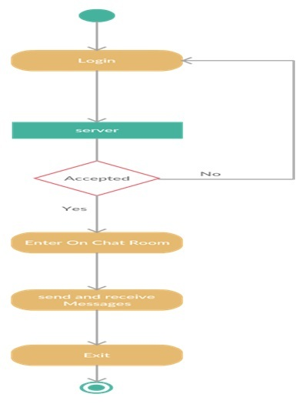
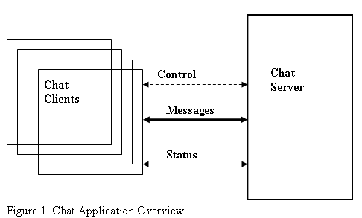

Slide 15
References
https://www.geeksforgeeks.org/python-programming-language/?ref=shm
https://slideplayer.com/slide/128https://slideplayer.com/slide/12833818/33818/
https://en.wikipedia.org/wiki/Python_Software_Foundation
https://1000logos.net/javascript-logo/
https://en.wikipedia.org/wiki/HTML#HTML_4
https://www.pngwing.com/en/free-png-hwwqg

Slide 16
Future Scope
There is always a room for improvements in any software package, however good and efficient it may be done. But the most important thing should be flexible to accept further modification right now we are just dealing with text communication. In future this software may be extended to include features like FILE TRANSFER and VOICE CHAT, etc.

Slide 17
DEMONSTRATION

Slide 18
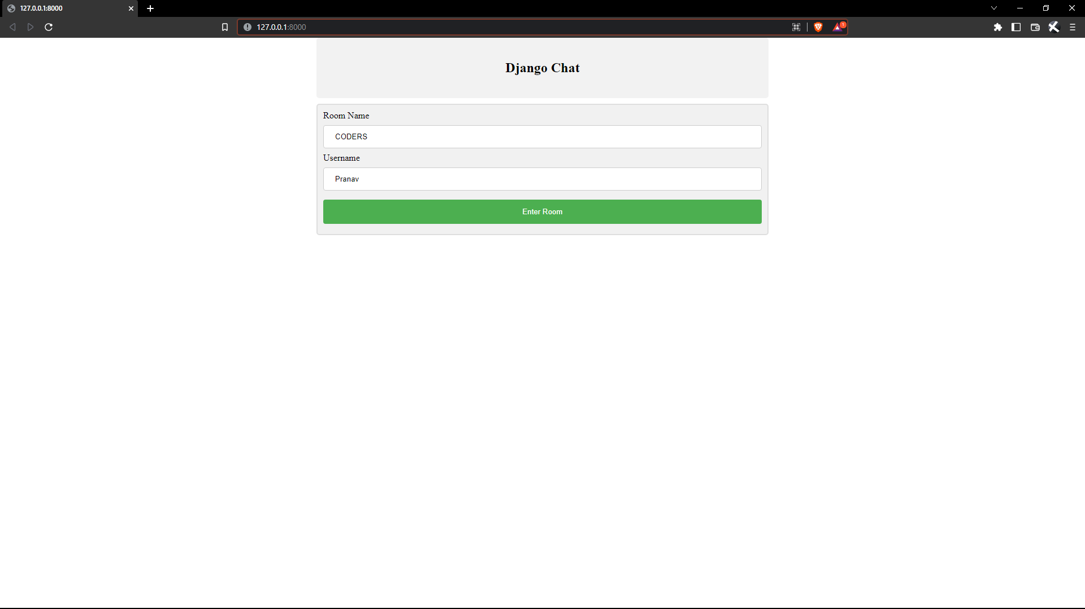
LOGIN PAGE

Slide 19
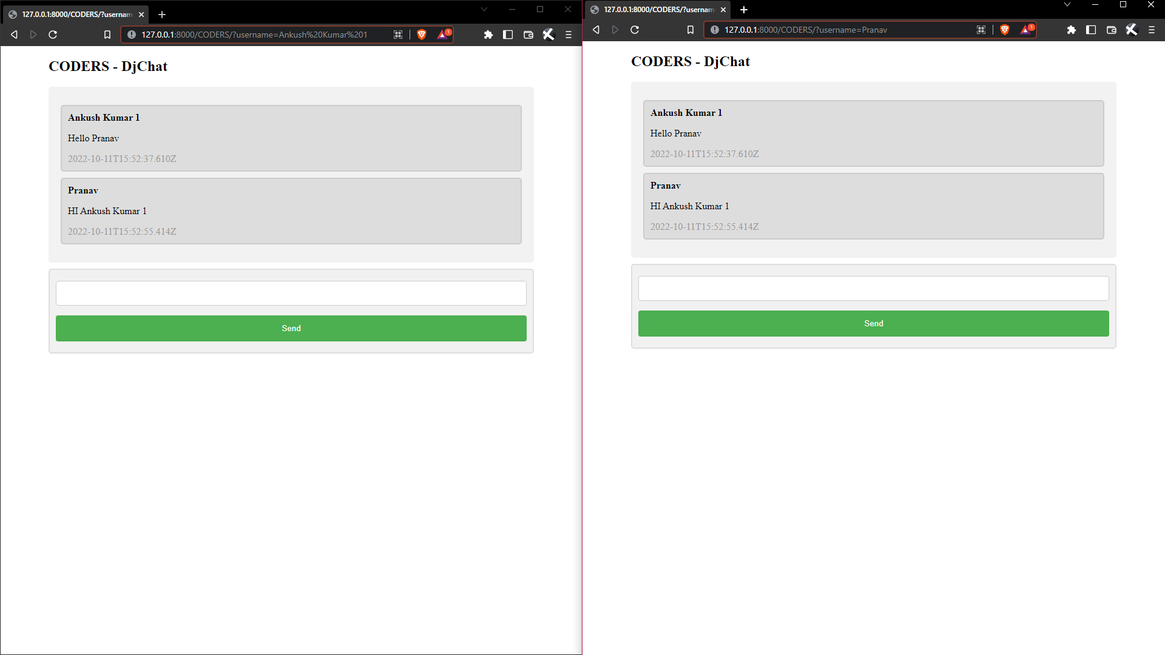
CHAT ROOM

Slide 20


